Slide 1

Self Driving Car Using Behavior Cloning
CSE 472: Machine Learning Project
Presented by:
Md. A. M. Reza Khan #1405061 Md. Nahiyan Uddin #1405102 Md. Mirajul Islam #1405119
Supervised by:
Md. Shariful Islam Bhuyan Assistant Professor Dept. of CSE, BUET
Department of Computer Science and Engineering,
Bangladesh University of Engineering and Technology, Dhaka, Bangladesh

Slide 2
Problem
How we can get train a deep learning model to predict steering wheel angles and help a virtual vehicle drive itself in a simulator.

Slide 3
Model Assistance
The model is created using Keras, relying on Tensorflow as the backend.

Slide 4
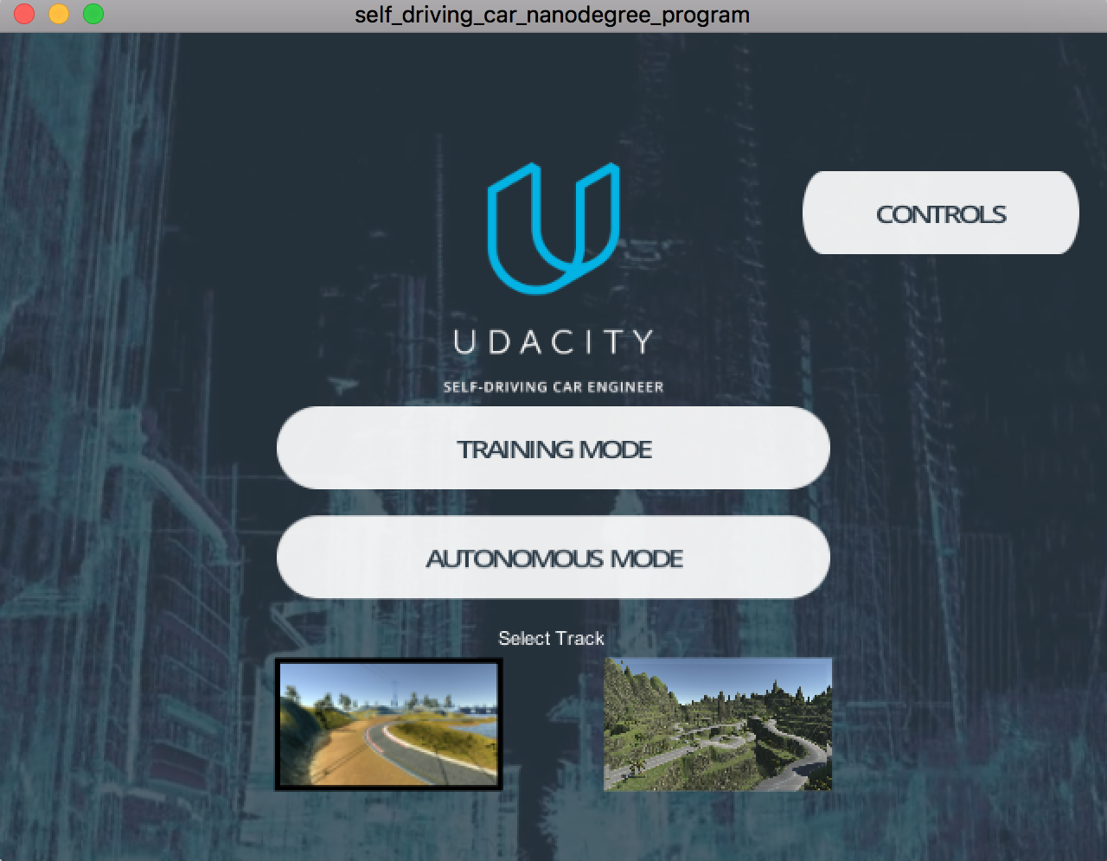
Project Setup

Slide 5
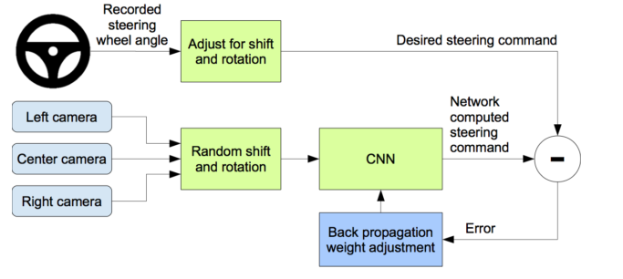
Flowchart

Slide 6
Datasets
Udacity's dataset on track 1
Our manually created dataset on track 1
Another manually created dataset on track 1 where we drive close to the bounds and recover to teach the model how to avoid going out of bounds
A manually created dataset on track 2

Slide 7
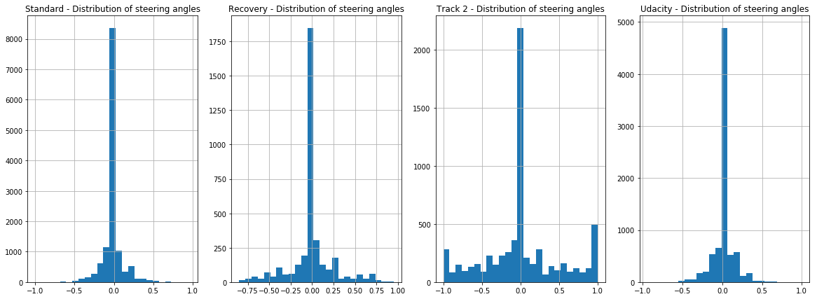
Dataset Exploration
Notes:
The data was greatly imbalanced, with an overwhelming number of steering wheel data being neutral (i.e. 0). This means, that unless we take corrective steps, our model will be biased to driving straight.

Slide 8

Dataset Split
We created an ensemble training dataset composed of:
Udacity dataset
Recovery dataset
dataset from track 2.
We decided to use the Standard dataset from track 1 as the validation set.
Notes:
The data was greatly imbalanced, with an overwhelming number of steering wheel data being neutral (i.e. 0). This means, that unless we take corrective steps, our model will be biased to driving straight.

Slide 9
Data Augmentation
Camera And Steering Wheel Angle Calibration
Image Horizontal Flip
Darken Image
Random Shadow
Shift Image Left/Right/Up/Down

Slide 10
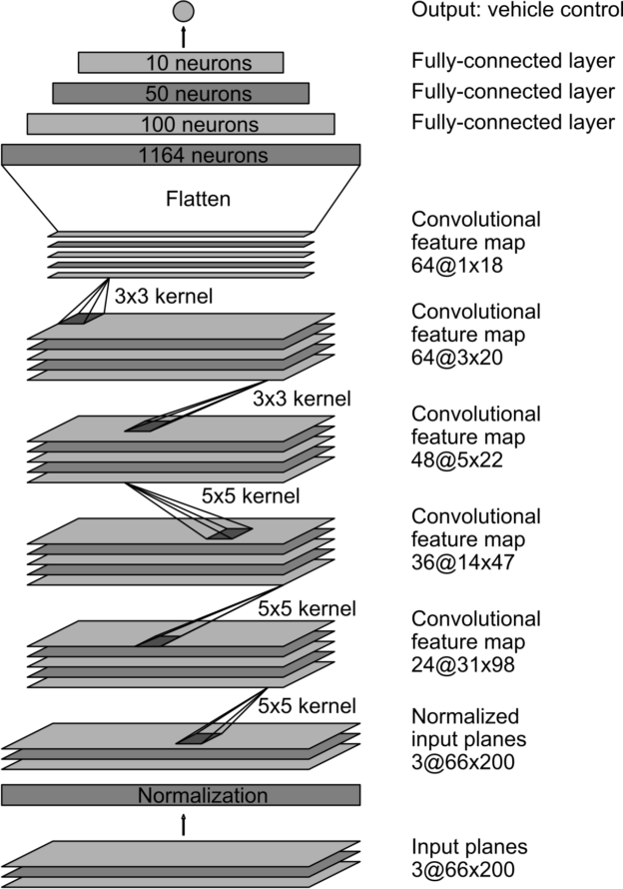
Model
VGG Architecture

Slide 11
Model Tweaks
We crop the top of the images so as to exclude the horizon (it doesn’t play a role in immediately determining the steering angle)
We resize the images to 66x200 as one the early layers to take advantage of the GPU
We apply Batch Normalization after each activation function for faster convergence.

Slide 12
Model Architecture (1)
Input image is 160x320 (height x width format)
Image is vertically cropped at the top, by removing half of the height (80 pixels), resulting in an image of 80x320
Cropped image is normalized, to make sure the mean of our pixel distribution is 0
Cropped image is resized to 66x200
We apply a series of 3 of 5x5 convolutional layers, using a stride of 2x2.

Slide 13
Model Architecture (2)
We apply a 2 consecutive 3x3 convolutional layers, with a depth of 64
We flatten the input at this stage and enter the fully connected phase
We apply a series of fully connected layers, of gradually decreasing sizes: 1164, 200, 50 and 10
The output layer is obviously of size 1, since we predict only one variable, the steering wheel angle

Slide 14
Activations And Regularization
The activation function used across all layers, bar the last one, is ReLU.
We tried ELU as well but got better results with ReLU + BatchNormalization.
We use the Mean Squared Error activation for the output layer since this is a regression problem, not a classification one.

Slide 15
Training & Results
We trained the model using Adam as the optimizer and a learning rate of 0.001. After much, tweaking of parameters, and experimentation of multiple models, we ended up with one that is able power our virtual car to drive autonomously on both tracks.

Slide 16
Conclusion
While we have obtained encouraging results, we would like in the future to explore the following:
Take into account speed and throttle in the model
Get the car to drive faster than 15-20MPH
Experiment with models based VGG/ ResNets/ Inception via transfer learning
Use Recurrent Neural Networks like in this paper from people using the Udacity dataset
Experiment with Reinforcement Learning

Slide 17
Acknowledgements
We would like to thank to:
Eddie Forson
Dominique Luna
Andrew
Aron Brown Stephen Welch
David Silver
Manav Kataria

Slide 18
Thank You

